Slide 1
Operational Investigation of Customer Differential Pressure (DP) Performance
Question Investigated
Under what operating conditions does customer DP fall below the 12 psi upset threshold?
Key Findings
Customer DP fell below the 12 psi upset threshold in 21% of observations.
Peak operating conditions increased threshold breaches by approximately 75% compared with non-peak operation.
Weather and system demand consistently showed the strongest association with reduced customer DP.
System output pressure was the strongest controllable operational variable associated with improved DP.
Business Objective
Identify the operational conditions associated with customer DP falling below the 12 psi upset threshold and recommend practical operational actions to reduce customer risk.

Slide 2
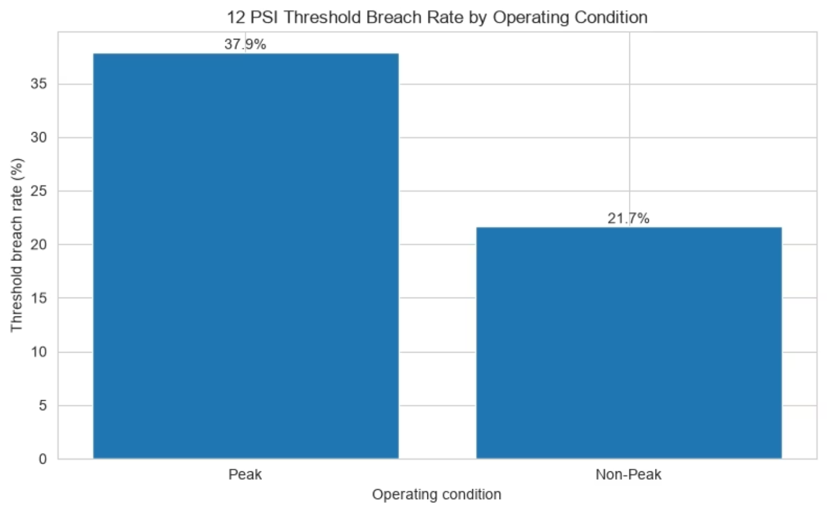
DP Risk Increases Materially During Peak Conditions

Slide 3
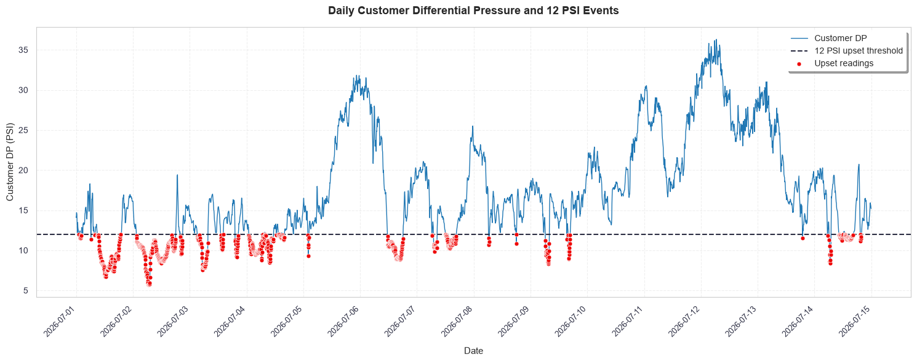
Customer DP Does not Deteriorate Randomly

Slide 4

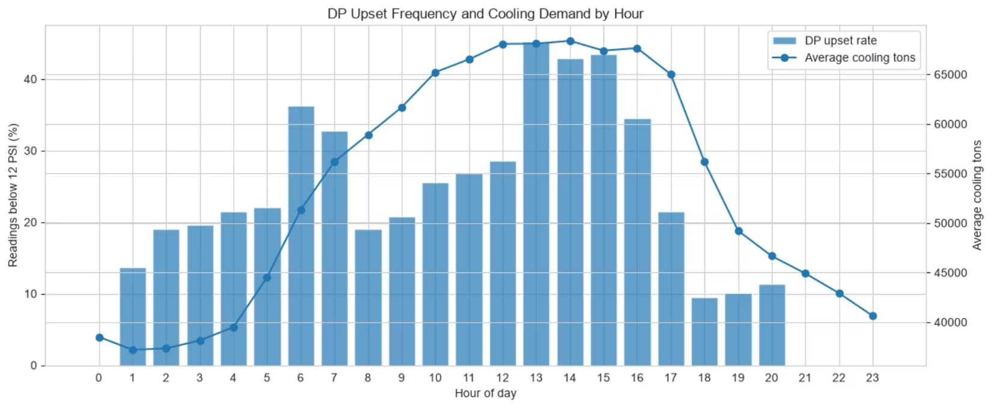
Customer DP risk peaks during the early-to-mid afternoon, aligning closely with the system's highest cooling demand.

Slide 5
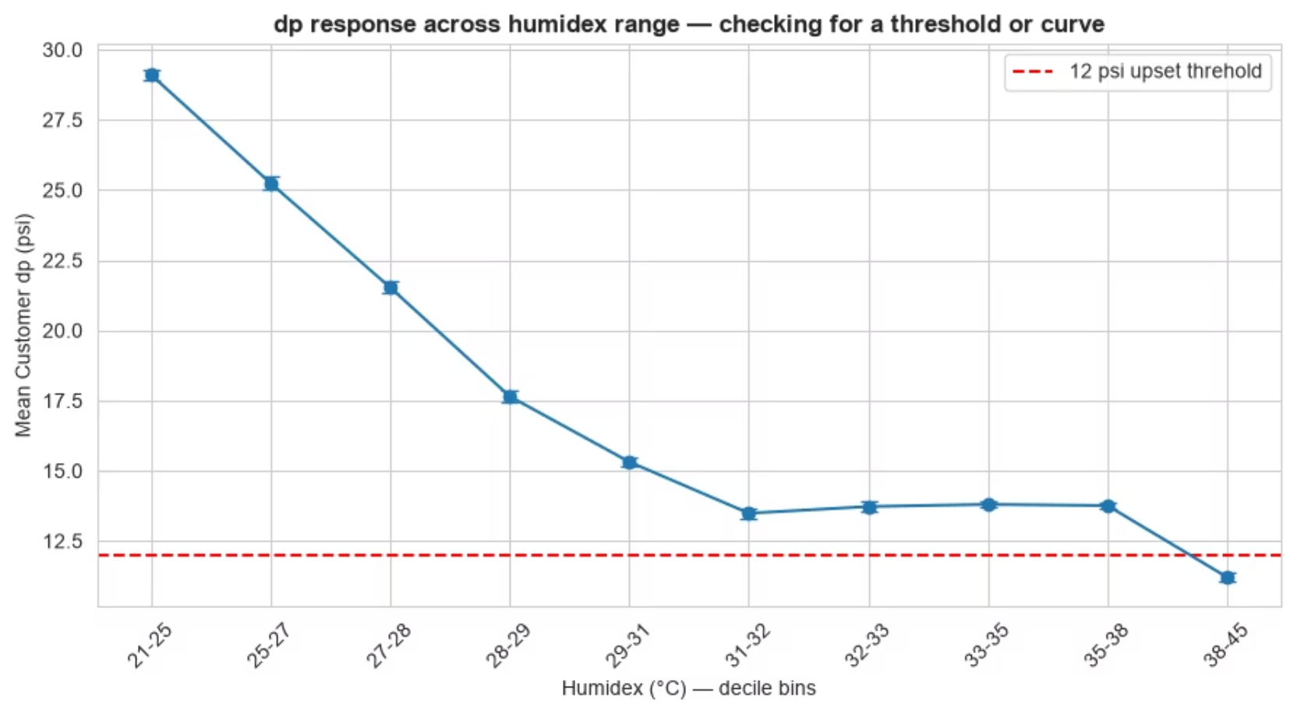

Slide 6
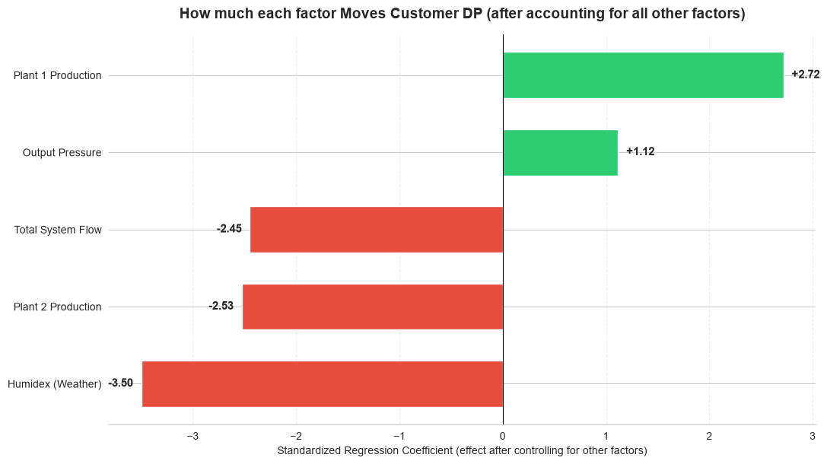
What Are the Main DP Drivers ?

Slide 7
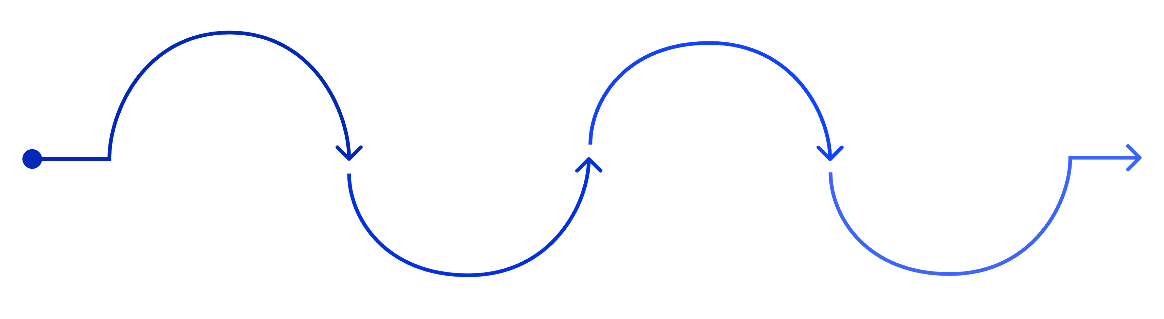
RECOMMENDATIONS
Move From Reactive to Proactive Risk Management
Short Term Actions
Medium Term Improvements
Introduce a warning band above 12 psi (e.g., 13–14 psi) to provide early alert before threshold breach — not after
Continue five-minute monitoring during peak conditions; hourly resolution is insufficient to capture the speed of DP deterioration during high-demand periods
Develop combined DP risk alerts that trigger on Humidex + flow combinations, not single-variable thresholds
Review output pressure strategy during forecast high-demand periods — it is the strongest controllable positive lever identified in the analysis
Review plant dispatch strategy — Plant 2's negative association with customer DP warrants investigation with Operations; Plant 1 and Plant 2 behave differently under load
Monitor upset event duration, not just frequency — a 20-minute breach has materially different customer impact than a 2-minute spike
Add predictive weather monitoring to operational planning; Humidex forecasts can provide 12–24 hour advance warning of elevated DP risk windows
Warning Band
Weather Dispatch
Predictive DP
Combined Alerts
Early alert above 12 psi
Forecast depressurization events
Merge sensor and operational signals
Adjust crew based on forecasts
Recommendations are prioritized based on operational feasibility, potential customer impact, and the statistical evidence observed during the analysis period. Validate recommendations jointly with Operations, Plant Chiefs, and Engineering before modifying dispatch or pressure strategies.

Slide 8
Thank you !
Questions & Discussion
by Nd Fyneface

